Slide 1
Safe Lifting techniques to avoid injury
Ergonomic injuries account for 35% of all worker’s compensation injuries in the United States. The goal of this tutorial is to identify injuries common to movers/material handlers and to explore various safe lifting techniques.

Slide 2
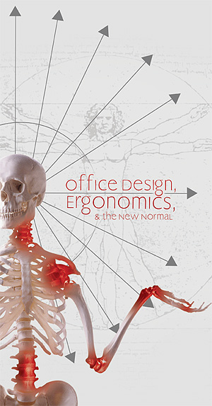
Ergonomics is fitting the work to the worker
Ergonomics is about “fit”. The fit between a person and what they do, the objects they use and the environments in which they work. If good fit is achieved, the stresses on people are reduced. They become comfortable, can do things efficiently and productively without discomfort.
An ergonomic evaluator will look for specific risk factors that may indicate a “poor” fit, and then make recommendations to reduce these risks which without resolution, could lead to a musculoskeletal/cumulative trauma disorder
Exposure to more than one risk factor increases the chances of experiencing discomfort.

Slide 3
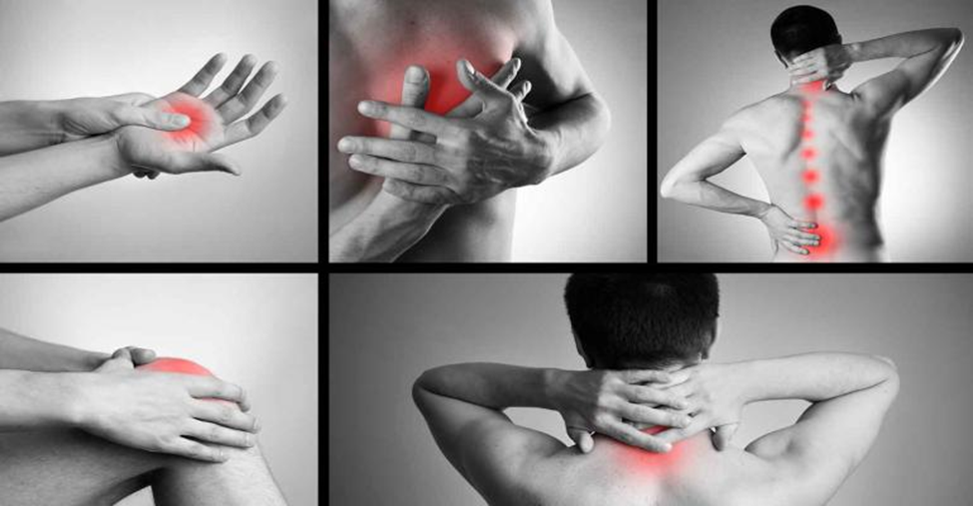
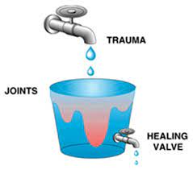
What are musculoskeletal/cumulative trauma disorders?
A musculoskeletal disorder is discomfort of the muscles, ligaments, tendons, joints or nerves which could include strain, sprain or inflammation which typically accumulates over time. They are NOT a diagnosis, but a class of disorders with similar characteristics.
Microtrauma experienced by the body on a daily basis can heal over time. But if we experience more trauma than the natural healing process can absorb, the result is a MSD/CT injury

Slide 4
Symptoms of musculoskeletal disorders
Symptom | Description or observation
Pain—sharp, shooting or dull | Most common symptom which may be present at rest or while using the injured body part
Tenderness | The part may be sensitive to the touch
Heat or burning | The body part may feel warmer than normal or even feel hot
Tingling and/or numbness | You may feel partial or intermittent tingling or some numbness over the injured area
Cramping or spasm | The muscles may remain in a cramped state or the muscle may suddenly and involuntarily contract
Clumsiness or weakness | You may find you are dropping things more frequently or things that were easy to hold previously are heavy to you now

Slide 5
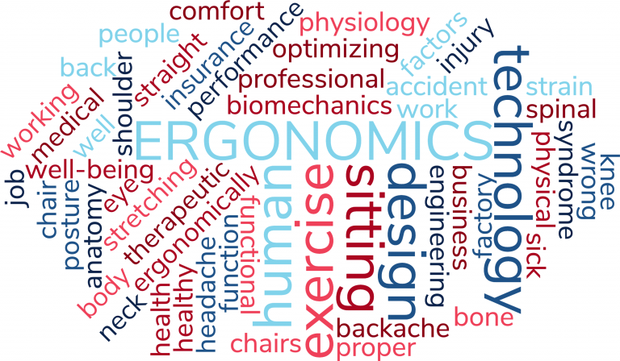
Why even bother with “ergonomics”?
Pre-pandemic study(2018) in the US found that ergonomic improvements resulted in:
75% reduction in lost workdays
48% decrease in turnover
CDC study(2015) found cost associated with lost productivity due to back pain $1,685 per case
MSD/CT Injuries can be controlled through ergonomic interventions

Slide 6
Ergonomic Risk Factors
Sustained Posture
Awkward Posture
Vibration
Forceful Exertions
Contact Stress
Ergonomic Risk Factors
Repeated Motions
These 6 ergonomic risk factors should be avoided whenever possible.
Note that many situations will expose you to more than one risk factor at a time.
.
Notes:
There is inherent ergonomic risk in the work we do. Although the presence of a risk factor does not guarantee an injury, these 6 ergonomic risk factors should be avoided whenever possible. Note that many situations will expose you to more than one risk factor at a time. Combining risk factors amplifies the danger. This lesson will focus on posture and rest as they are most relevant to sit-stand desks.

Slide 7

Because Musculoskeletal disorders develop over time, there are ways to reduce injury risk
Change the way you do your work
Use equipment
Change the environment
Let’s discuss these three ways to reduce injuries…

Slide 8
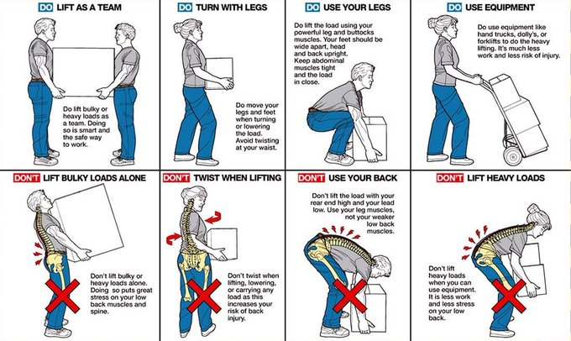
Change how you work:
Injuries can occur by:
Lifiting and twisting at the same time

Slide 9
Change how you work:
Injuries can occur by:
Lifting bulky or odd shaped objects

Slide 10
Change how you work:
Injuries can occur by:
Bending at the waist and lifting at the same time

Slide 11
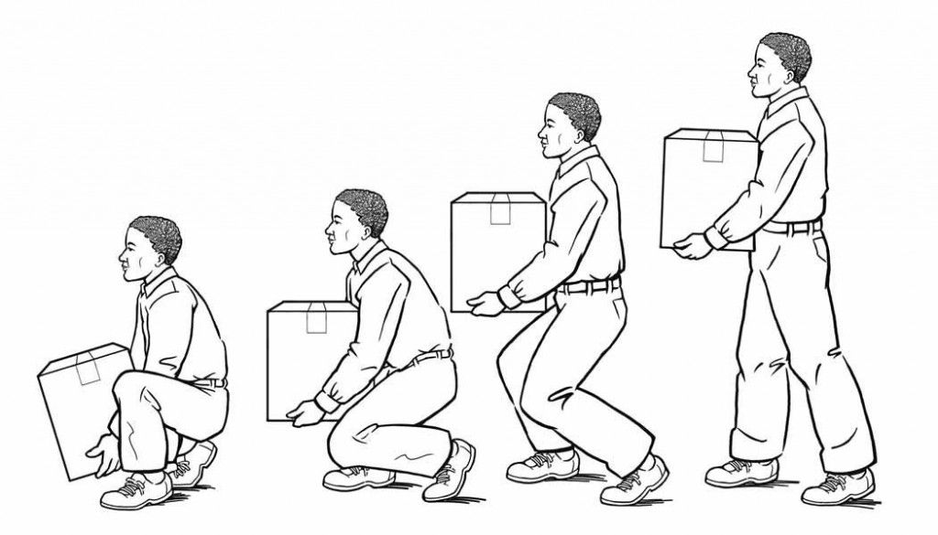
Change how you work:
There are many safe ways to lift a load

Slide 12
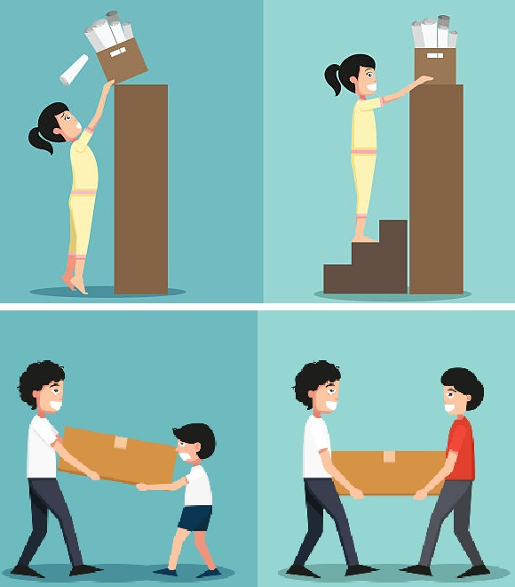
Change how you work:
Injuries can occur by:
Lifting and reaching for an object that is too high
Don’t Lift heavy objects from overhead
Do raise yourself to be closer to the load

Slide 13
Change how you work:
Injuries can occur by:
Pulling instead of pushing
Don’t pull a load when you can push it
Do push a load, even a handcart

Slide 14
Change how you work:
Injuries can occur by:
Lifting a load that is too heavy

Slide 15
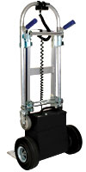
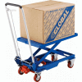
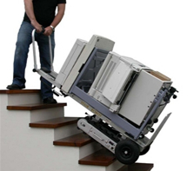
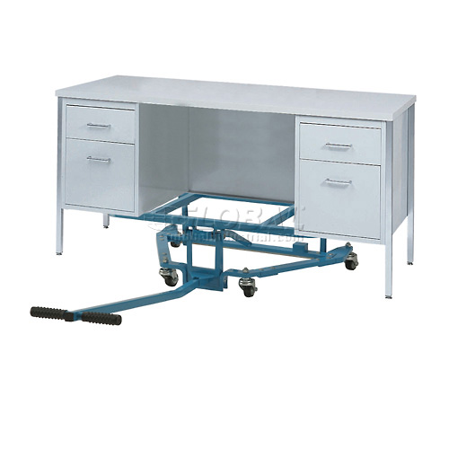

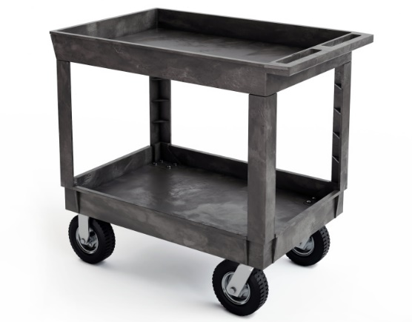
Change how you work:
Use Equipment

Slide 16
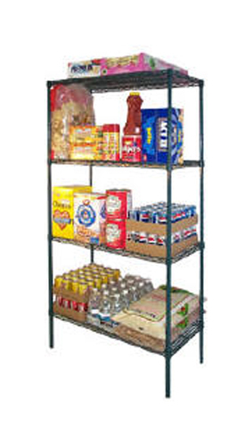
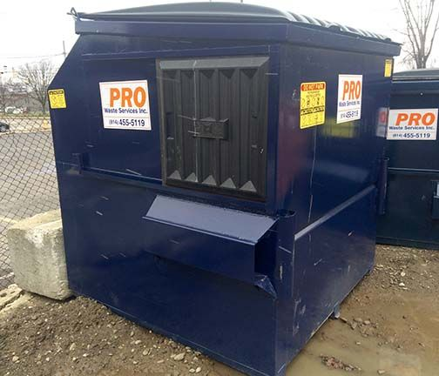
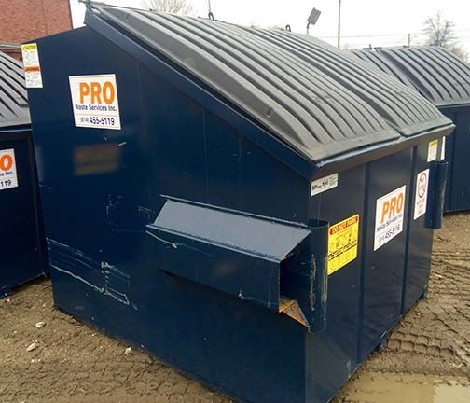
Change how you work:
Change your environment
Dumpsters with “windows” instead of lifting lid to dispose of trash
Reorient supplies on shelves to allow heaviest items between knee and waist height, lightest items on top

Slide 17
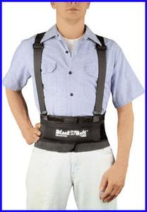
Back Belts – good or bad?
NIOSH reports there is no compelling evidence that back belts prevent back injury or back pain.

Slide 18
Summary
Musculoskeletal Injury risk can be reduced with work method change, equipment use and environmental changes. Don’t be a statistic, think before you work and work smarter, not harder.

Slide 19
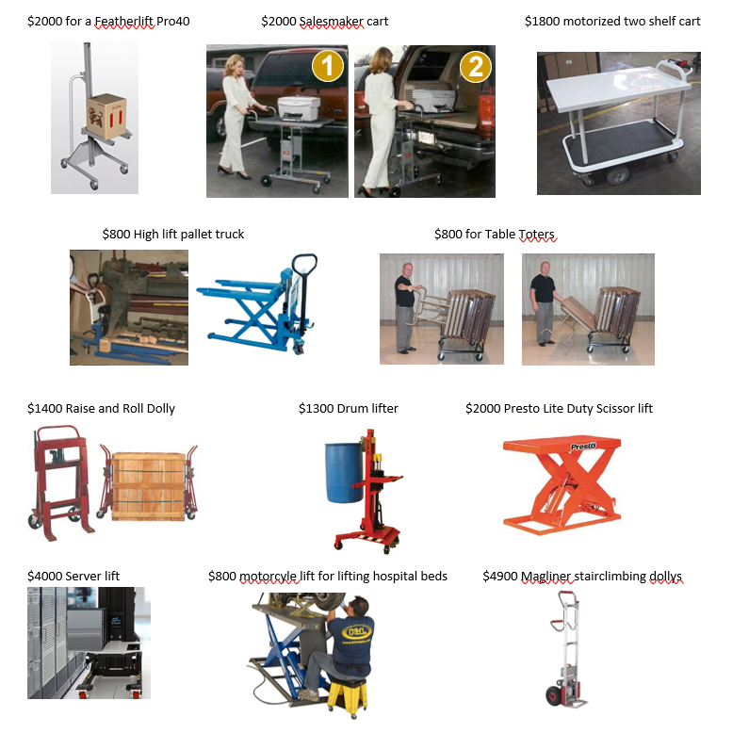
If you are not sure what you need, contact EHS ergonomics
EHSErgonomics@umich.edu

Slide 20
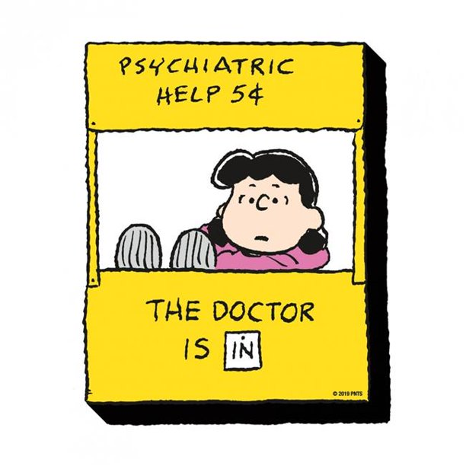
Ergonomic
Sarah Cooney, OTR/L
Senior Ergonomics Professional
University of Michigan
Environment, Health and Safety
scooney@umich.edu
734-763-7704
EHSErgonomics@umich.edu

