Slide 1
Ergonomic Survival Guide in the Laboratory; Methods to reduce injury
Sarah Platt Cooney, OTR/L
Senior Ergonomics Professional
University of Michigan

Slide 2
Ergonomics is fitting the work to the worker in order to reduce risk of injury/discomfort
Ergonomics is about “fit”. The fit between a person and what they do, the objects they use and the environments in which they work. If good fit is achieved, the stresses on people are reduced. They become comfortable, can do things efficiently and productively without discomfort.
An ergonomic evaluator will look for specific risk factors that may indicate a “poor” fit, and then make recommendations to reduce these risks
Exposure to more than one risk factor increases the chances of experiencing discomfort.

Slide 3
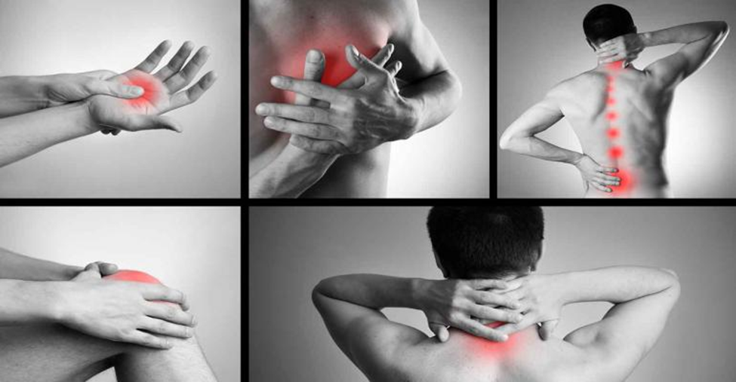
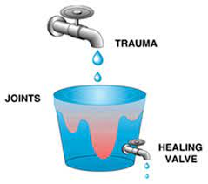
What are musculoskeletal/cumulative trauma disorders?
A musculoskeletal disorder is discomfort of the muscles, ligaments, tendons, joints or nerves which could include strain, sprain or inflammation which typically accumulates over time. They are NOT a diagnosis, but a class of disorders with similar characteristics.
Microtrauma experienced by the body on a daily basis can heal over time. But if we experience more trauma than the natural healing process can absorb, the result is a MSD/CT injury

Slide 4
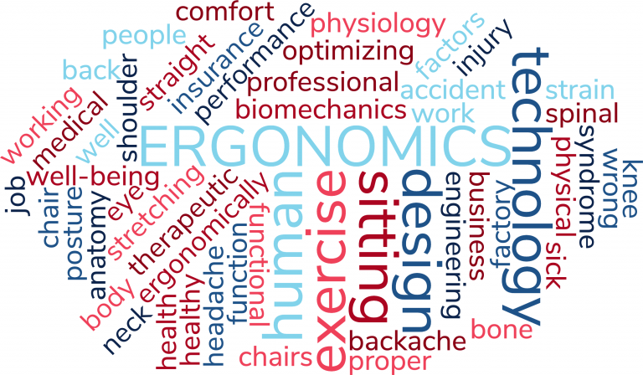
Why even bother with “ergonomics”?
Pre-pandemic study(2018) in the US found that ergonomic improvements resulted in:
75% reduction in lost workdays
48% decrease in turnover
2021 study of Laboratory workers found 77% of current employees reported experiencing MSD discomfort.

Slide 5
Awkward Posture
Sustained Posture
Contact Stress
Forceful Exertions
Inadequate Rest
Ergonomic Risk Factors
Repeated Motions
These 6 ergonomic risk factors should be avoided whenever possible.
Note that many situations will expose you to more than one risk factor at one time

Slide 6
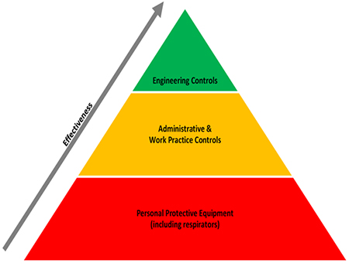
Three ways to reduce risk
Most effective:
Engineer out the risk by implementing carts, lifts, microscope retrofits, height adjustable equipment/tables etc…
Moderately effective:
Job rotation—ie: changing the job tasks so that the same body motion is not repeated or sustained.
Job enlargement—ie: 2 employees share tasks so one employee so the same body motion is not repeated or sustained
Administrative Controls
Work Method modification, education
Least effective:
Telling the worker how to position themselves or how to “safely” lift/push/pull/carry

Slide 7
Awkward Postures occur when the body works from a position that is not neutral.

Slide 8
Awkward Postures occur when the body works from a position that is not neutral.
Extended reach—the user could move closer in the chair to avoid this reach. Elbow should be close to the side and no further forward than 4-5”.

Slide 9
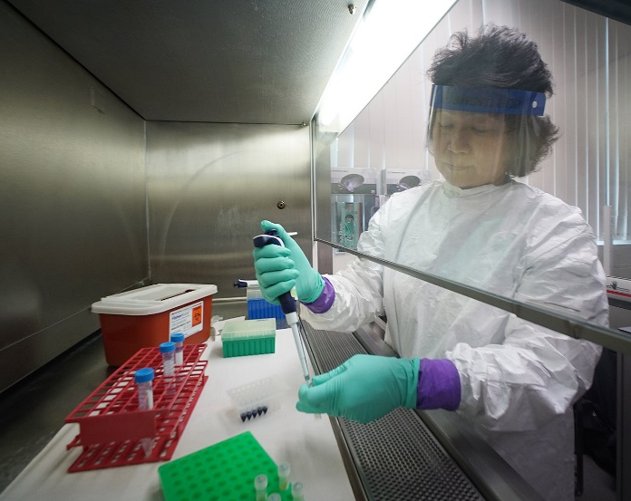
Awkward Postures occur when the body works from a position that is not neutral
Minimize reach by storing frequently used materials nearby or use a carousal to rotate things you need within the fume/biohazard hood
Position to the work or position the work. That may mean raising or lowering the seat height.

Slide 10
Before and After adjustments: Microscope
1. Move microscope closer to upright sitting position.
2. Determine if eye cups can be adjusted to your position, instead of positioning yourself to the eyecups.
3. Consider retrofit of microscope if possible

Slide 11
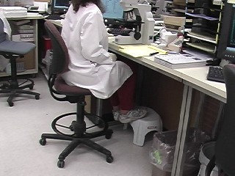
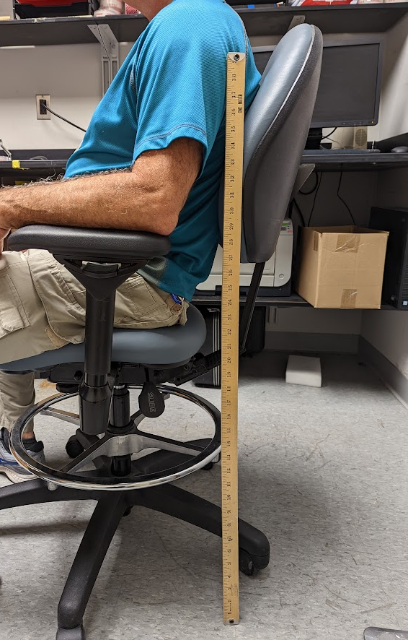
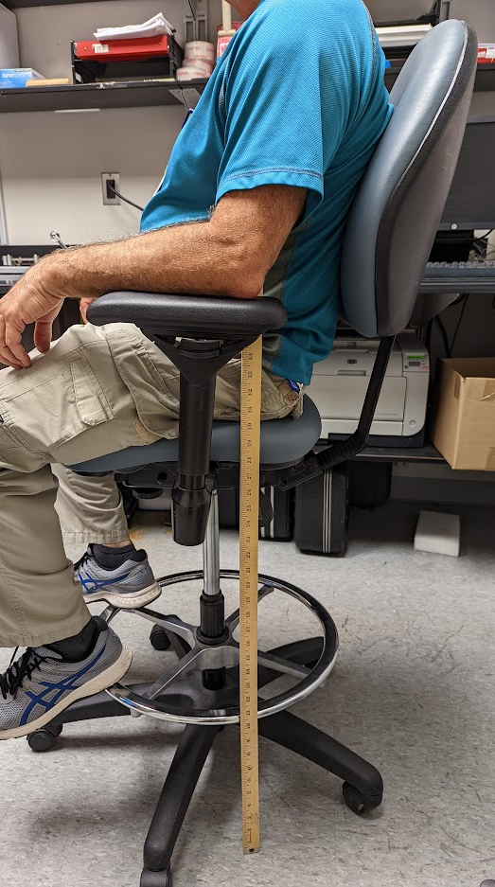
Awkward posture: design solutions
Obstructed leg room increases forward reach. Keep storage out of legroom
Purchase stools that have a “2-stage” cylinder to allow for maximum height adjustability. Look for infinite lock seat and backrest so users can adjust to their posture

Slide 12
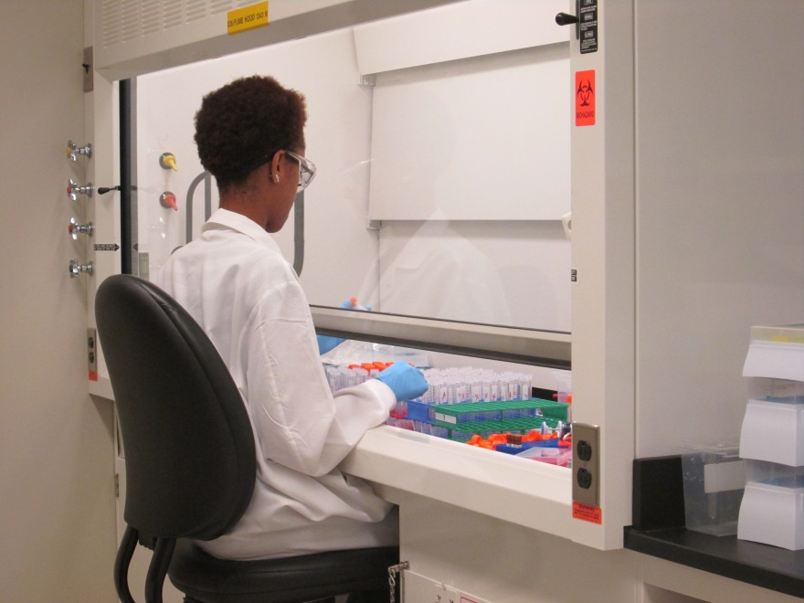
Contact Stress: Damage to the tissue of the body caused by contact between soft tissue and a hard object.

Slide 13
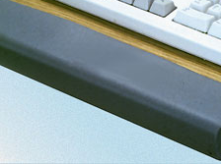
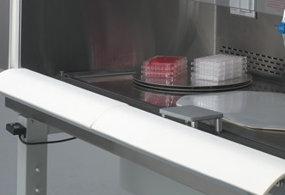
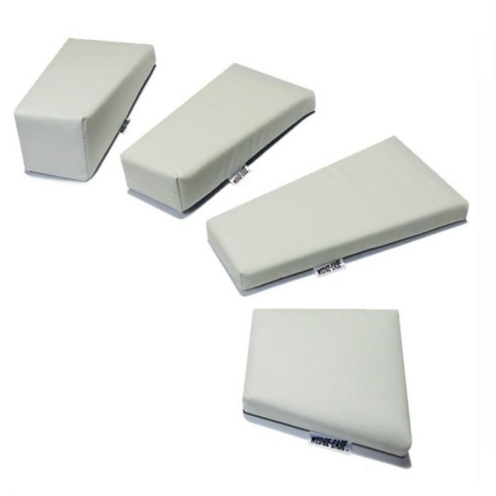
Contact Stress solutions

Slide 14
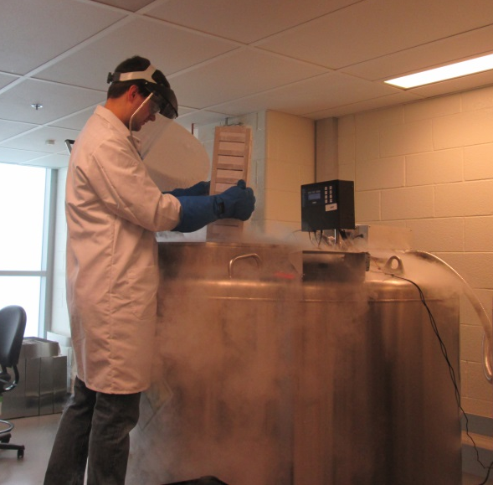
Forceful exertion occurs when muscles and ligaments are asked to interact with a heavy load.
Automation is always preferred to manual lifting to reduce forces of lifting

Slide 15
Forceful exertion occurs when muscles and ligaments are asked to interact with a heavy load.
Forceful pinch solutions
Reverse forceps-stay closed until pinched
Low force forceps—reduces the pinch force required

Slide 16
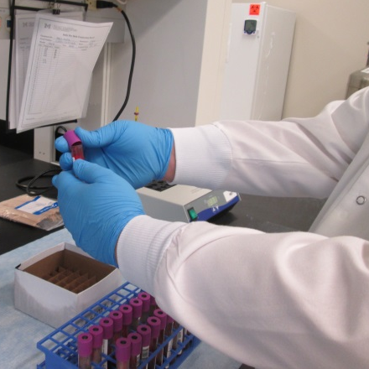
Forceful exertion occurs when muscles and ligaments are asked to interact with a heavy load.
Grip objects/handles with the whole hand rather than just the fingers
Use tools designed for use with the whole hand, not just a finger or two
Make sure gloves fit snuggly as loose fitting ones increase necessary grip
Forces applied to a finger or thumb act with four times the force on your tendons
Performing fine motor skills all day may fatigue your hands, wrists, and forearms or lead to inflammation

Slide 17
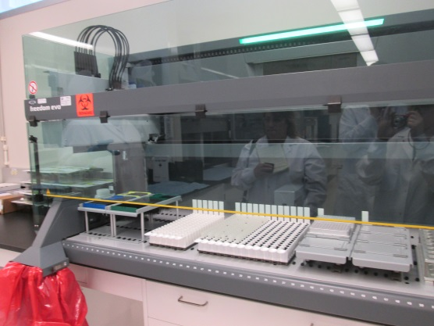
Repetition occurs when the same body motion occurs over and over again
Use mechanical methods when ever possible
Change the way you engage in the task to not overstress the same muscles. For example, switch hands while filling the centrifuge
Spread out the frequency of an action by doing other tasks to allow tired muscles to rest. Divide up long spells of uncapping, labeling, pipetting or recapping by alternating through the entire cycle a few times

Slide 18
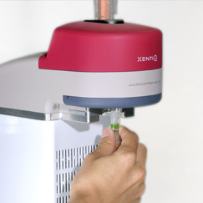
Repetition
Pinch turn of attaching caps on microtubes
Can’t change how much work there is to be done, but can change how it is done with an engineering solution. Buy or 3-D print a method to screw on/off caps

Slide 19
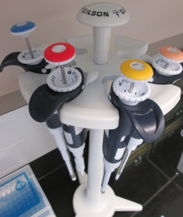
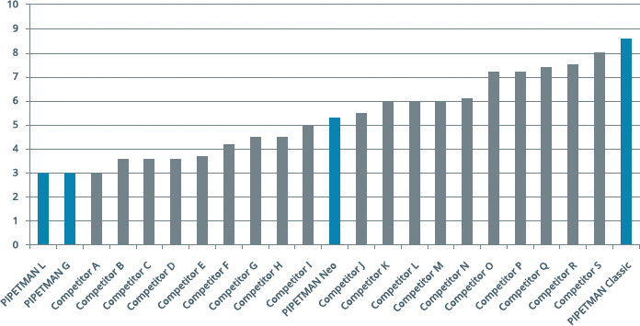
Forceful exertion and repetition
For repetitive tasks, such as pipetting, choose the tool that requires the least force because forces applied to a finger or thumb act with four times the force on your tendons.

Slide 20
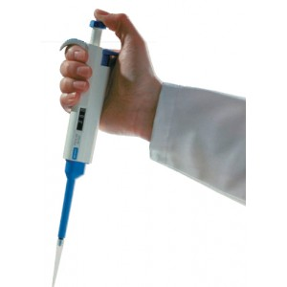
Pipetting Repetition, awkward posture, force

Slide 21
Robotic pipetters Engineering solution to eliminate repetition
This is an excellent solution to environments with high repetition, and multiple risk factors like use within a glove box

Slide 22
If you are not sure what you need, contact EHS ergonomics EHSErgonomics@umich.edu

Slide 23
Ergonomic
Sarah Cooney, OTR/L
Senior Ergonomics Professional
University of Michigan
Environment, Health and Safety
scooney@umich.edu
734-763-7704
EHSErgonomics@umich.edu

