Slide 1
Embedded Laser Safety Training
You must use MS PowerPoint “Slide Show” mode to view this presentation and its animations.
University of Michigan
Environment, Health & Safety
The following information is intended for use of University of Michigan employees and students. The UM EHS Department assumes no liability or responsibility for any non-UM entity using the information - use at your own risk.

Slide 2
Embedded Laser Safety Basic Training
Self-Study Module
This online ‘embedded laser safety training’ is only a part of the training requirements.
Lab Director (LD) must also deliver lab/device -specific instruction to each user.
Records of that instruction must be kept by the LD and made available upon request.

Slide 3
Responsibilities of Lab Directors
  Evaluate laser hazards & institute appropriate controls (with EHS advice as appropriate)
  Implement safety procedures:
    Develop written Standard Operating Procedures (SOP)
    Provide personal protective equipment, if necessary
    Conduct and document specific training for all users

Slide 4
In this training
What is a laser and what is dangerous about it?
What is an embedded laser and what are its advantages?
How to remain as safe as possible when using equipment containing an embedded laser
What to do if someone is injured

Slide 5
Embedded Laser Safety Basic Training
After completing this training, you should be able to:
    Identify the risks of using equipment containing lasers
    Know how to avoid increasing the risks
    Recognize and take action if something bad happens when using embedded lasers.

Slide 6
What is a LASER? Why is it hazardous?
A laser is a device that makes very powerful electromagnetic waves (including visible ones) :
LASER stands for:
Light Amplification by Stimulated Emission of Radiation.
The energy in this non-ionizing electromagnetic radiation is very useful for many applications but more energy also makes it more dangerous.

Slide 7


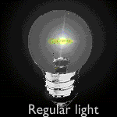
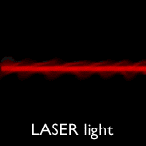
Compare the following types of light
  Regular light sources emit light that has:
  Multiple wavelengths (polychromatic)
  Waves out of phase
  Multi-directional
  Intensity decreases rapidly
  Laser light:
  1 wavelength (monochromatic)
  Waves in phase (coherent)
  Goes in one direction (directional)
  Intensity can go some distance

Slide 8
Types of injury that enough light energy of differing wave length can cause
Wavelength Range | Eye | Skin
Ultraviolet C 200-280 nm Ultraviolet B 280-315 nm Ultraviolet A 315-400 nm | Photokeratitis Photokeratitis Photochemical cataract | Sunburn Skin Cancer Accelerated skin aging Increased pigmentation Pigment darkening Skin burn
Visible (400 nm - 700 nm) | Photochemical Thermal retinal injury | Pigment darkening Skin burn
Near-infrared 700-1400 nm Mid-infrared 1400-3000 nm Far-infrared 3000-1,000,000 nm | Cataract and retinal burn Corneal burn Corneal burn Aqueous flare, cataract Corneal burn | Skin burn Skin burn Skin burn

Slide 9
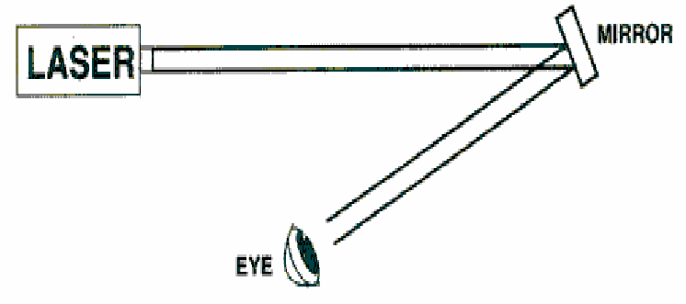
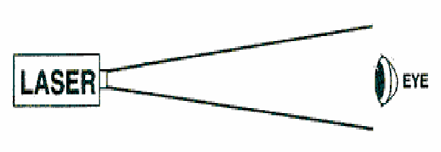
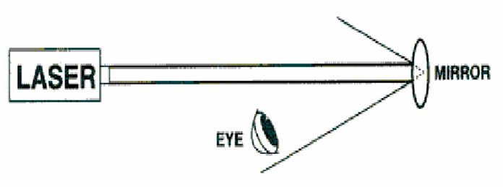
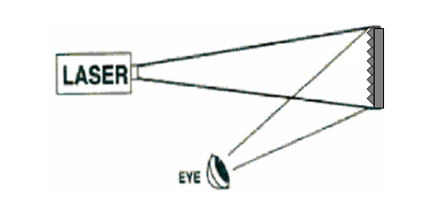
Viewing a laser beam directly or when reflected can cause eye damage
Likely to cause harm if enough energy
Specular Reflection (flat surface)
Direct Beam
ALSO likely to cause harm:
Specular Reflection (curved surface)
Viewing the beam from
a distance from the side
is unlikely to cause harm
but there must be no
reflections.
Diffuse Reflection

Slide 10
To use a laser beam safely, it is important to know:
What is the maximum energy/power
What is its wavelength (visible, invisible- UV, IR)
How well the laser beam is shielded and controlled so that users and non-target materials are protected
This information has been combined to classify lasers into seven classes.

Slide 11
The lower the number, the less overall risk,
if the equipment is used correctly/maintained properly.
Class 1 – “Considered incapable of producing damaging radiation levels during operation.”
Common example is an embedded higher class laser.
The laser beam may be powerful enough to cause serious injury, but physical shielding and control mechanisms mean risk of exposure to users, and anything else except the intended target, is minimized.
For this reason, specialized personal protective equipment is not usually required. Check with your Lab Director to be sure.

Slide 12
Class 1M – A Class 1 system with magnifying optics. Example is a communication fiber optics system.
Class 2 –Eyes are protected because of the natural blinking response. Example is a supermarket bar scanner.
Class 2M - A Class 2 laser with optical aid. Example is a construction industry laser
Class 3R – Most laser pointers. Typically the red dot used in a laser cutter to line up material. Eye may be protected using natural blinking response.
Class 3B - These can be hazardous under direct and specular reflection viewing. Diffusive reflection and fire are not normally a hazard with Class 3B. Many embedded systems contain Class 3B lasers, but these systems have shielding and interlocks to prevent direct viewing of the beam.
Class 4 – Laser inside a laser cutter is a high powered laser. Both direct and scattered (diffuse) beams can cause eye and skin damage. Do not override interlock.

Slide 13
All these pieces of equipment may contain
“embedded’ lasers:
Confocals
TIRF microscopes
Two-photon microscopes
Cytometers
Mass Spectrometers
Laser Cutters

Slide 14
‘Embedded’ lasers are completely enclosed in a
solid casing. In confocals and other microscopes
containing lasers, their beams travel along optical
cables to site of use.
These systems also have interlocks to prevent
accidental exposure to a beam. If interlocks are
bypassed, injury or exposure may occur.
There is still risk of exposure and injury if the
casing/cables are damaged or removed.

Slide 15
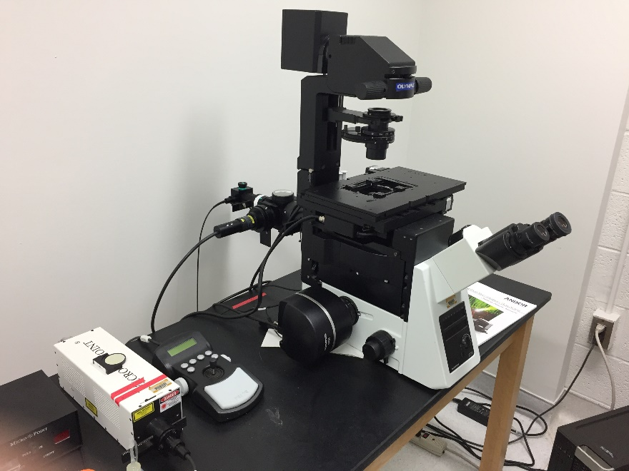
Engineering Control Measures
  Protective Housings
Confocal with laser and fiber optic cables. Head
pivots back and interlock prevents direct viewing of
laser beam if instrument is on.

Slide 16
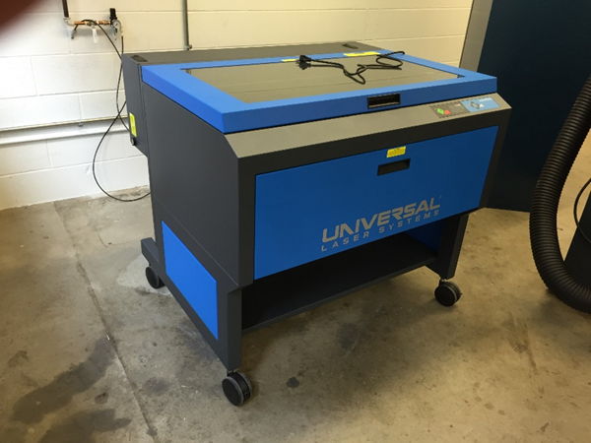
Engineering Control- Interlocks
Laser cutter with high power laser. Laser beam that cuts is invisible. Red dot is Class 3R like a laser pointer.
If panel on top or in front is opened during operation,
interlocks should shut the device down.

Slide 17
Therefore to minimize risk of injury
Never try to see inside, break or remove any casing,
or expose the lasers or laser beams
Never try to override an interlock mechanism
Never let untrained people use the equipment
If you think there is something wrong with a laser or interlock: report it to your Lab Director
Only specialized laser personnel from laser manufacturer may repair, or service embedded laser equipment.

Slide 18
Stay healthy to stay safe!
Electrical Hazard
  More than a dozen fatal electrocutions in laser-related accidents have been reported in America.
  The principal factors influencing the accidents in order of their frequencies are user-related:
    Fatigue
    Hunger
    Medication
    Alcohol
    Drug
These are your responsibility!
Do not continue to use equipment if
you have problems with these!

Slide 19
How to work safely with lasers
Understand how to use specific equipment that includes lasers
2. Have training to understand
what you must do
and
what you must not do to stay safe
Read the Laser ‘Safe operating procedure’ for your lab!
Make sure your work place is properly labelled
3. Know how to get help
if the equipment isn’t working properly (in any way)
if there might be a problem with laser, interlock, or protective cover
if there is an injury or potential injury situation

Slide 20
Standard Operating Procedure (SOP)
A concise document that gives safety instructions specific to the laser and associated equipment.
    It should include:
      a System Description
      Eye, Skin and Non-beam Hazards
      Control Measures and Emergency Procedures
      Training Requirements
      List of Approved Personnel
Let your Lab Director know if you think any information is missing or needs updating

Slide 21
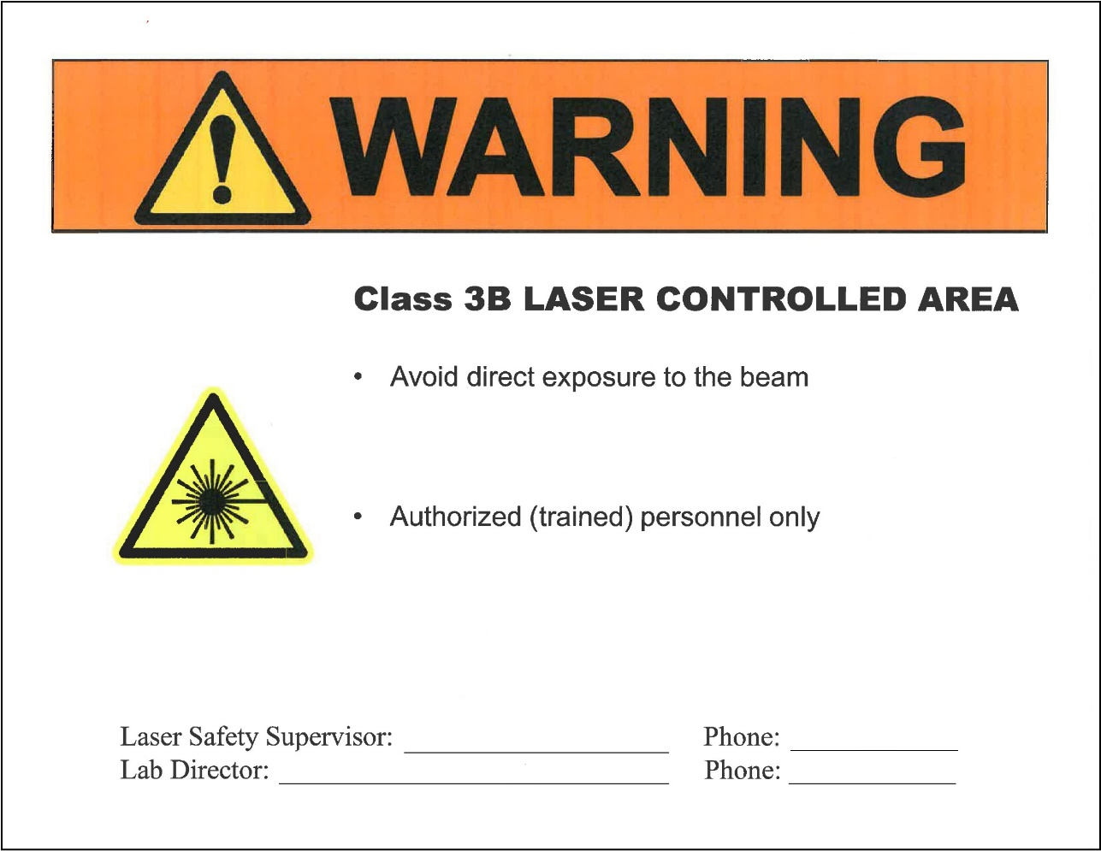
Important ways to ensure everyone is protected from laser-related injuries
Prominent door signs
Check with your Lab
Director/EHS Laser
Safety Officer that
your workplace has the
correct signage
Make sure these details
are filled in, you may need
to use them

Slide 22
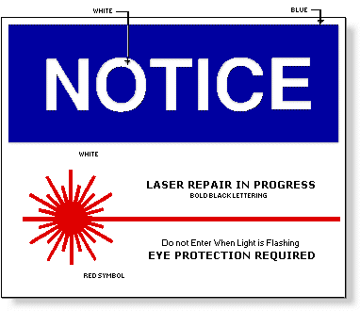
If the laser beam may be exposed,
everyone must be warned not to enter the room!
e.g. when an embedded laser is being aligned, repaired or serviced by qualified experts

Slide 23
Embedded laser equipment has been designed to reduce the risk of direct laser beam-related injury to an minimum.
However, if you think you have been exposed to the laser beam/are injured:
Evacuate the room and shut the door,
Tell others not to enter and why so that the room can be labelled as potentially dangerous. Inform EHS.
Get help with going to the emergency room/occupational health if required
Fill out an accident report or help lab manager or lab director to do so.

Slide 24
What Do I Do in an Emergency?
If it is an emergency, go to the U-M Hospital System Emergency Room (UMHS - ER).
For non-emergency treatment:
Employees of U-M should go to Occupational Health Services, Monday – Friday from 7:00 am – 4:30 pm; after hours or on weekends go to the UMHS – ER.
Students of U-M should go to University Health Services.
If injured, notify your advisor and you must complete the Work Connections Illness/Injury Report Form http://www.workconnections.umich.edu/employees/work-related-illness-injury/step-one/
If you do not fill out this form, you will be billed directly.
Notes:
Hours of operation:
7:00 am - 4:30 pm, Monday – Friday
Closed: Weekends and official U-M holidays
After hours go to the U-M Emergency Room

Slide 25
U-M Occupational Health Services
7:00 am – 4:30 pm
Monday - Friday
C380 Med Inn Building
University of Michigan Hospitals
1500 E. Medical Center Drive
Ann Arbor, MI 48109-5838
Phone: (734) 764-8021
Fax: (734) 763-7405
For evenings/weekends/holidays, please use the UMHS Emergency room.

Slide 26
Applicable Standards, Regulations, and Guidelines
American National Standard for Safe Use of Lasers (ANSI Z136.1-2014)
American National Standard for Safe Use of Lasers in research, development, or testing (ANSI 2136.8-2012)
General Duty Clause [29 CFR 1910.5(a)(1)]
  “Each employer shall furnish a place of employment which is free from recognized hazards that are likely to cause death or physical harm to employees”
Laser Product Performance Standard (21 CFR 1040.10 and 1040.11)
EHS Laser Safety Guideline:
  http://ehs.umich.edu/wp-content/uploads/2016/02/LaserSafety.pdf

Slide 27
Thank you for your time in completing this presentation.
We hope you have found its content both useful and informative.
For further questions and/or inquiries, please contact:
Laser Safety Officer at 734-647-5224 or
UM Environment, Health and Safety at
http://ehs.umich.edu

